Slide 1
Data Preprocessing_2
CSE402A
Data Mining
B. Tech. CSE, 2017
Course Leader:
Mohan Kumar K N
mohan.cs.et@msruas.ac.in

Slide 2
Objectives
At the end of this lecture, student will be able to
Describe different data reduction method and steps.
Apply and analyze Dimensionality reduction, Numerosity reduction, Data compression methods.

Slide 3
Outline
Data Reduction
Dimensionality reduction
Numerosity reduction
Data compression
Summary
3

Slide 4
Data Reduction Strategies
Data reduction: Obtain a reduced representation of the data set that is much smaller in volume but yet produces the same (or almost the same) analytical results
Why data reduction? — A database/data warehouse may store terabytes of data. Complex data analysis may take a very long time to run on the complete data set.
Data reduction strategies
Dimensionality reduction, e.g., remove unimportant attributes
Wavelet transforms
Principal Components Analysis (PCA)
Feature subset selection, feature creation
Numerosity reduction (some simply call it: Data Reduction)
Regression and Log-Linear Models
Histograms, clustering, sampling
Data cube aggregation
Data compression

Slide 5
Data Reduction 1: Dimensionality Reduction
Curse of dimensionality
When dimensionality increases, data becomes increasingly sparse
Density and distance between points, which is critical to clustering, outlier analysis, becomes less meaningful
The possible combinations of subspaces will grow exponentially
Dimensionality reduction
Avoid the curse of dimensionality
Help eliminate irrelevant features and reduce noise
Reduce time and space required in data mining
Allow easier visualization
Dimensionality reduction techniques
Wavelet transforms
Principal Component Analysis
Supervised and nonlinear techniques (e.g., feature selection)
Notes:
5

Slide 6
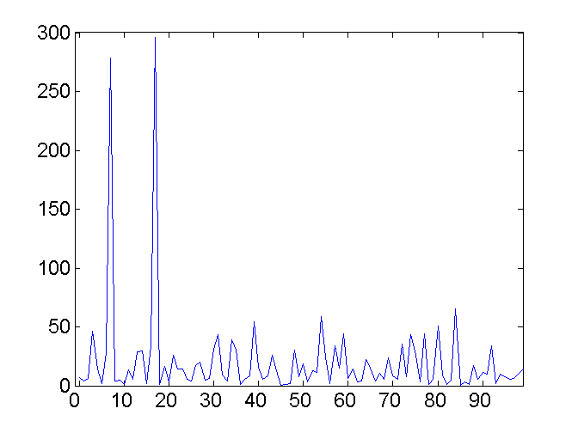
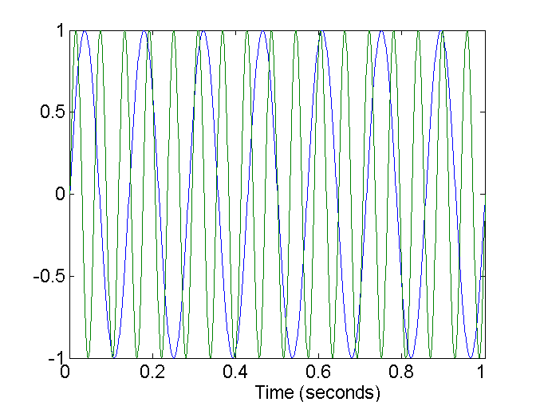
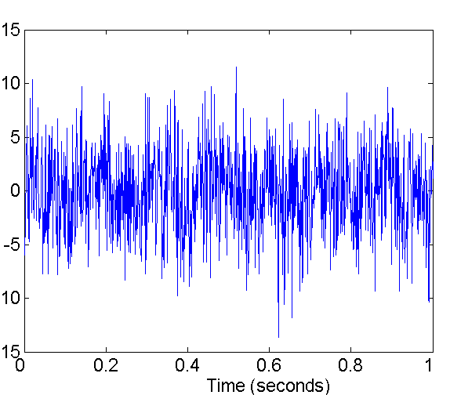
Mapping Data to a New Space
Fourier transform
Wavelet transform
Frequency
Two Sine Waves
Two Sine Waves + Noise
Notes:
6

Slide 7
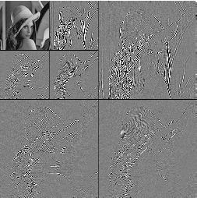
What Is Wavelet Transform?
Decomposes a signal into different frequency subbands
Applicable to n-dimensional signals
Data are transformed to preserve relative distance between objects at different levels of resolution
Allow natural clusters to become more distinguishable
Used for image compression
Notes:
7

Slide 8
Wavelet Transformation
Discrete wavelet transform (DWT) for linear signal processing, multi-resolution analysis
Compressed approximation: store only a small fraction of the strongest of the wavelet coefficients
Similar to discrete Fourier transform (DFT), but better lossy compression, localized in space
Method:
Length, L, must be an integer power of 2 (padding with 0’s, when necessary)
Each transform has 2 functions: smoothing, difference
Applies to pairs of data, resulting in two set of data of length L/2
Applies two functions recursively, until reaches the desired length
Haar2
Daubechie4
Notes:
8

Slide 9
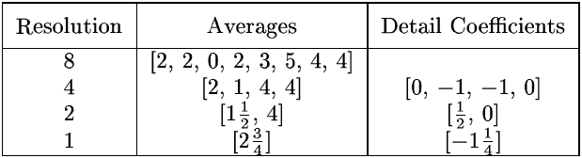
Wavelet Decomposition
Wavelets: A math tool for space-efficient hierarchical decomposition of functions
S = [2, 2, 0, 2, 3, 5, 4, 4] can be transformed to S^ = [2³/₄, -1¹/₄, ¹/₂, 0, 0, -1, -1, 0]
Compression: many small detail coefficients can be replaced by 0’s, and only the significant coefficients are retained
Notes:
9

Slide 10
Haar Wavelet Coefficients
Coefficient “Supports”
₊
Hierarchical decomposition structure (a.k.a. “error tree”)
2.75
₋
2.75
₊
+
-1.25
₋
+
-1.25
-
₊
0.5
₋
0.5
0
₊
+
-
+
-
0
₋
0
-1
-1
0
₊
0
₋
+
-
+
-
+
-
+
-
₊
₋
-1
2 2 0 2 3 5 4 4
₊
-1
₋
₊
Original frequency distribution
0
Notes:
10

Slide 11
Why Wavelet Transform?
Use hat-shape filters
Emphasize region where points cluster
Suppress weaker information in their boundaries
Effective removal of outliers
Insensitive to noise, insensitive to input order
Multi-resolution
Detect arbitrary shaped clusters at different scales
Efficient
Complexity O(N)
Only applicable to low dimensional data
Notes:
11

Slide 12
Principal Component Analysis (PCA)
Find a projection that captures the largest amount of variation in data
The original data are projected onto a much smaller space, resulting in dimensionality reduction. We find the eigenvectors of the covariance matrix, and these eigenvectors define the new space
x₂
e
x₁

Slide 13
Principal Component Analysis (Steps)
Given N data vectors from n-dimensions, find k ≤ n orthogonal vectors (principal components) that can be best used to represent data
Normalize input data: Each attribute falls within the same range
Compute k orthonormal (unit) vectors, i.e., principal components
Each input data (vector) is a linear combination of the k principal component vectors
The principal components are sorted in order of decreasing “significance” or strength
Since the components are sorted, the size of the data can be reduced by eliminating the weak components, i.e., those with low variance (i.e., using the strongest principal components, it is possible to reconstruct a good approximation of the original data)
Works for numeric data only

Slide 14
Attribute Subset Selection
Another way to reduce dimensionality of data
Redundant attributes
Duplicate much or all of the information contained in one or more other attributes
E.g., purchase price of a product and the amount of sales tax paid
Irrelevant attributes
Contain no information that is useful for the data mining task at hand
E.g., students' ID is often irrelevant to the task of predicting students' GPA

Slide 15
Heuristic Search in Attribute Selection
There are 2^{d} possible attribute combinations of d attributes
Typical heuristic attribute selection methods:
Best single attribute under the attribute independence assumption: choose by significance tests
Best step-wise feature selection:
The best single-attribute is picked first
Then next best attribute condition to the first, ...
Step-wise attribute elimination:
Repeatedly eliminate the worst attribute
Best combined attribute selection and elimination
Optimal branch and bound:
Use attribute elimination and backtracking

Slide 16
Attribute Creation (Feature Generation)
Create new attributes (features) that can capture the important information in a data set more effectively than the original ones
Three general methodologies
Attribute extraction
Domain-specific
Mapping data to new space (see: data reduction)
E.g., Fourier transformation, wavelet transformation, manifold approaches (not covered)
Attribute construction
Combining features (see: discriminative frequent patterns in Chapter 7)
Data discretization
Notes:
16

Slide 17
Data Reduction 2: Numerosity Reduction
Reduce data volume by choosing alternative, smaller forms of data representation
Parametric methods (e.g., regression)
Assume the data fits some model, estimate model parameters, store only the parameters, and discard the data (except possible outliers)
Ex.: Log-linear models—obtain value at a point in m-D space as the product on appropriate marginal subspaces
Non-parametric methods
Do not assume models
Major families: histograms, clustering, sampling, …

Slide 18
Parametric Data Reduction: Regression and Log-Linear Models
Linear regression
Data modeled to fit a straight line
Often uses the least-square method to fit the line
Multiple regression
Allows a response variable Y to be modeled as a linear function of multidimensional feature vector
Log-linear model
Approximates discrete multidimensional probability distributions

Slide 19
Regression Analysis
y
Regression analysis: A collective name for techniques for the modeling and analysis of numerical data consisting of values of a dependent variable (also called response variable or measurement) and of one or more independent variables (aka. explanatory variables or predictors)
The parameters are estimated so as to give a "best fit" of the data
Most commonly the best fit is evaluated by using the least squares method, but other criteria have also been used
Y1
Y1’
y = x + 1
X1
x
Used for prediction (including forecasting of time-series data), inference, hypothesis testing, and modeling of causal relationships

Slide 20
Regress Analysis and Log-Linear Models
Linear regression: Y = w X + b
Two regression coefficients, w and b, specify the line and are to be estimated by using the data at hand
Using the least squares criterion to the known values of Y₁, Y₂, …, X₁, X₂, ….
Multiple regression: Y = b₀ + b₁ X₁ + b₂ X₂
Many nonlinear functions can be transformed into the above
Log-linear models:
Approximate discrete multidimensional probability distributions
Estimate the probability of each point (tuple) in a multi-dimensional space for a set of discretized attributes, based on a smaller subset of dimensional combinations
Useful for dimensionality reduction and data smoothing

Slide 21
Histogram Analysis
Divide data into buckets and store average (sum) for each bucket
Partitioning rules:
Equal-width: equal bucket range
Equal-frequency (or equal-depth)

Slide 22
Clustering
Partition data set into clusters based on similarity, and store cluster representation (e.g., centroid and diameter) only
Can be very effective if data is clustered but not if data is “smeared”
Can have hierarchical clustering and be stored in multi-dimensional index tree structures
There are many choices of clustering definitions and clustering algorithms
Cluster analysis will be studied in depth in Chapter 10

Slide 23
Sampling
Sampling: obtaining a small sample s to represent the whole data set N
Allow a mining algorithm to run in complexity that is potentially sub-linear to the size of the data
Key principle: Choose a representative subset of the data
Simple random sampling may have very poor performance in the presence of skew
Develop adaptive sampling methods, e.g., stratified sampling:
Note: Sampling may not reduce database I/Os (page at a time)

Slide 24
Types of Sampling
Simple random sampling
There is an equal probability of selecting any particular item
Sampling without replacement
Once an object is selected, it is removed from the population
Sampling with replacement
A selected object is not removed from the population
Stratified sampling:
Partition the data set, and draw samples from each partition (proportionally, i.e., approximately the same percentage of the data)
Used in conjunction with skewed data

Slide 25
Sampling: With or without Replacement
SRSWOR
(simple random
sample without
replacement)
SRSWR
Raw Data

Slide 26
Sampling: Cluster or Stratified Sampling
Raw Data
Cluster/Stratified Sample

Slide 27
Data Cube Aggregation
The lowest level of a data cube (base cuboid)
The aggregated data for an individual entity of interest
E.g., a customer in a phone calling data warehouse
Multiple levels of aggregation in data cubes
Further reduce the size of data to deal with
Reference appropriate levels
Use the smallest representation which is enough to solve the task
Queries regarding aggregated information should be answered using data cube, when possible
Notes:
27

Slide 28
Data Reduction 3: Data Compression
String compression
There are extensive theories and well-tuned algorithms
Typically lossless, but only limited manipulation is possible without expansion
Audio/video compression
Typically lossy compression, with progressive refinement
Sometimes small fragments of signal can be reconstructed without reconstructing the whole
Time sequence is not audio
Typically short and vary slowly with time
Dimensionality and numerosity reduction may also be considered as forms of data compression
Notes:
28

Slide 29
Data Compression
Original Data
Compressed
Data
lossless
Original Data
Approximated
lossy
Notes:
29

Slide 30
Summary
Data reduction
Dimensionality reduction
Numerosity reduction
Data compression

Slide 31
Reference
a. Essential Reading
1. Class Notes
2. Bramer, M. (2007) Principles of Data Mining. Springer
b. Recommended Reading
1. Torgo, L. (2011) Data Mining with R: Learning with Case Studies. Chapman & Hall
2. Kecman, V. (2001) Learning and Soft Computing. The MIT Press
3. Witten, I. H., Frank, E., and Hall, M. A. (2011) Data Mining: Practical Machine Learning
Tools and Techniques, 3rd edn. Morgan Kaufmann

